Slide 1
DESSERT WINE “CATEGORIES” – METHODS OF PREPARATION & PRODUCTION
1. SPARKLING
  Example: Moscato d’Asti, Champagne demi-sec
2. LATE HARVEST
  Example: “Late Harvest Riesling”, German “Spatlese” Riesling
  ALSO sub-category: NOBLE ROT / BOTRYTIS affected grapes
    Sauternes, Tokaji, “Beerenauslese” Riesling
  ALSO sub-category: ICE WINE
    German “Eiswein” Riesling
3. PARTIALLY DRIED / RAISINED / “STRAW MAT” WINES
  Example: Recioto della Valpolicella, Vin Santo, Italian “Passito” wines
4. FORTIFIED WINES
  Example: Port
  ALSO sub-category: OXIDIZED WINES
    Sherry, Madeira

Slide 2
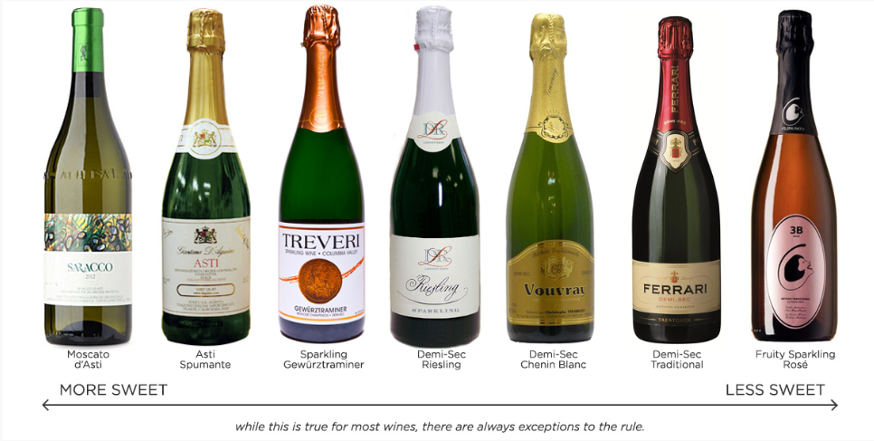
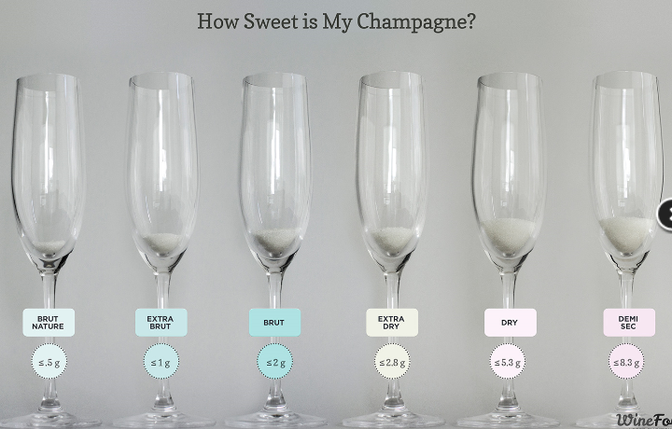
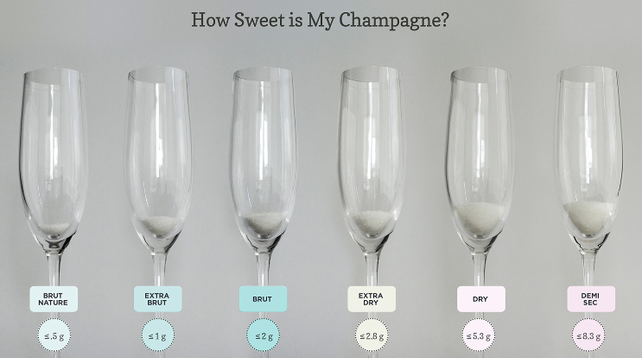
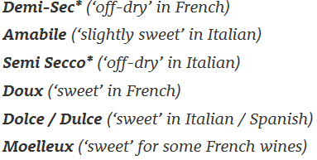
SPARKLING WINES
And of course – CHAMPAGNE ….
Increasing sweetness
Also – “DOUX” (the sweetest)

Slide 3
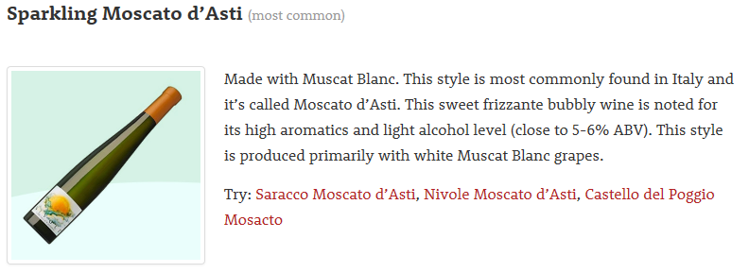
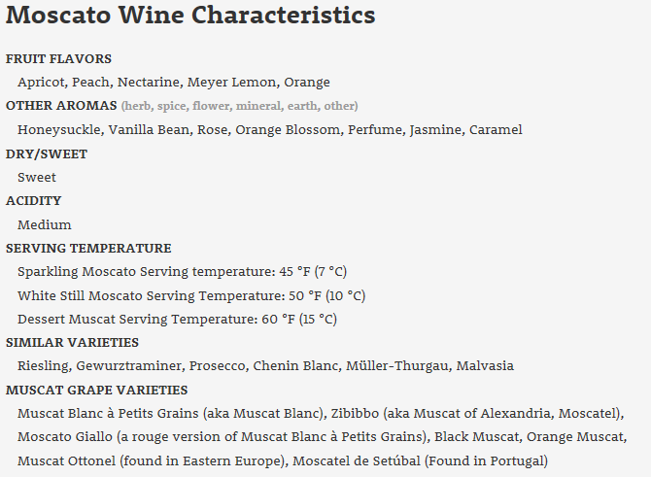
Tasting Wine:
Saracco Moscato d’Asti ~$15 from Esquin

Slide 4
DESSERT WINE “CATEGORIES” – METHODS OF PREPARATION & PRODUCTION
1. SPARKLING
  Example: Moscato d’Asti, Champagne demi-sec
2. LATE HARVEST
  Example: “Late Harvest Riesling”, German “Spatlese” Riesling
  ALSO sub-category: NOBLE ROT / BOTRYTIS affected grapes
    Sauternes, Tokaji, “Beerenauslese” Riesling
  ALSO sub-category: ICE WINE
    German “Eiswein” Riesling
3. PARTIALLY DRIED / RAISINED / “STRAW MAT” WINES
  Example: Recioto della Valpolicella, Vin Santo, Italian “Passito” wines
4. FORTIFIED WINES
  Example: Port
  ALSO sub-category: OXIDIZED WINES
    Sherry, Madeira

Slide 5
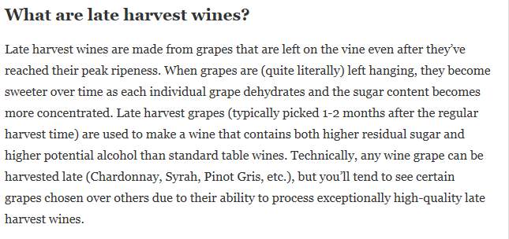
LATE HARVEST WINES

Slide 6
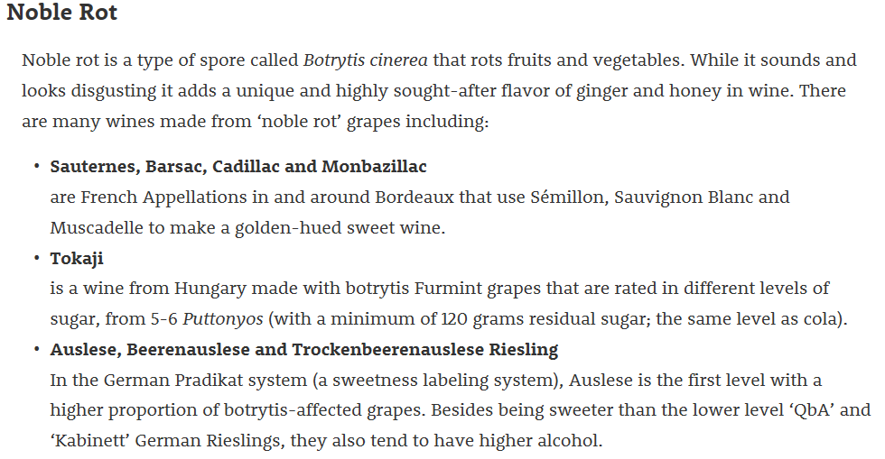
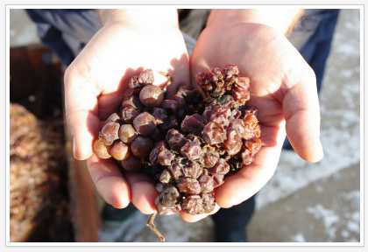
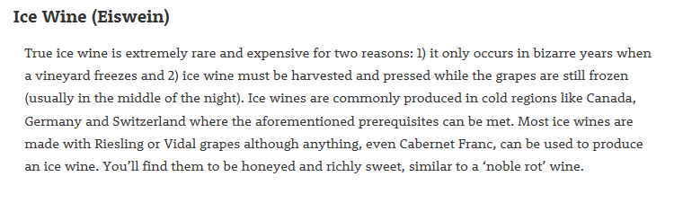
LATE HARVEST WINES – special types

Slide 7
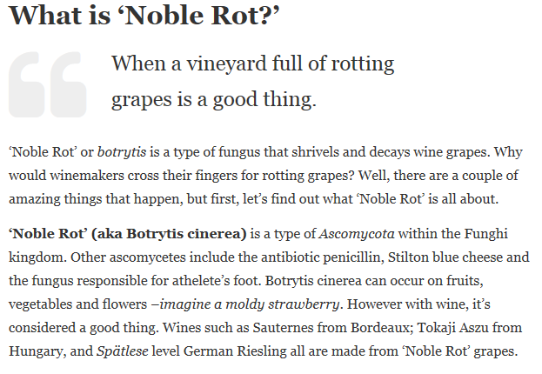
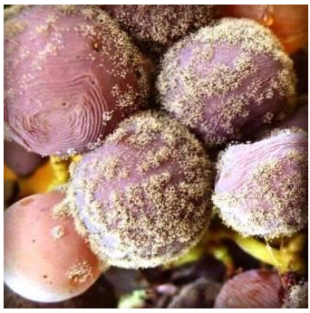
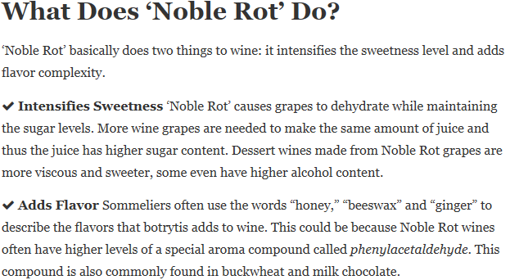
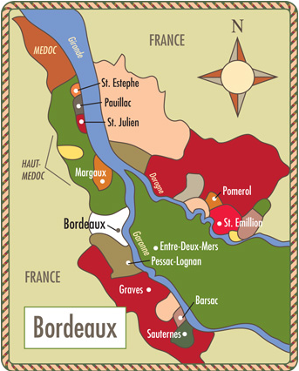
LATE HARVEST WINES – with Botrytis / “Noble Rot”
SAUTERNES:
-late harvest Semillon, Sauvignon Blanc & Muscadelle
-Botrytis / “Noble Rot” affected

Slide 8
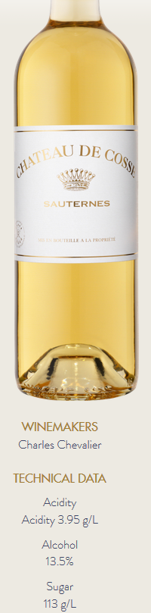
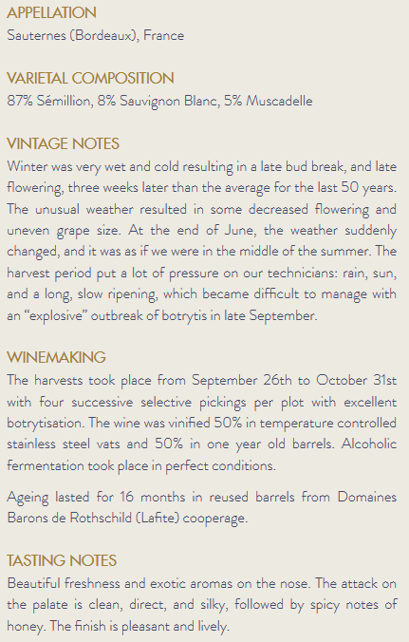
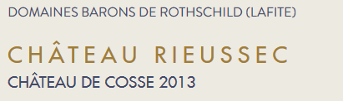
Tasting Wine:
Chateau De Cosse Sauterne ~$33/375ml from Esquin

Slide 9
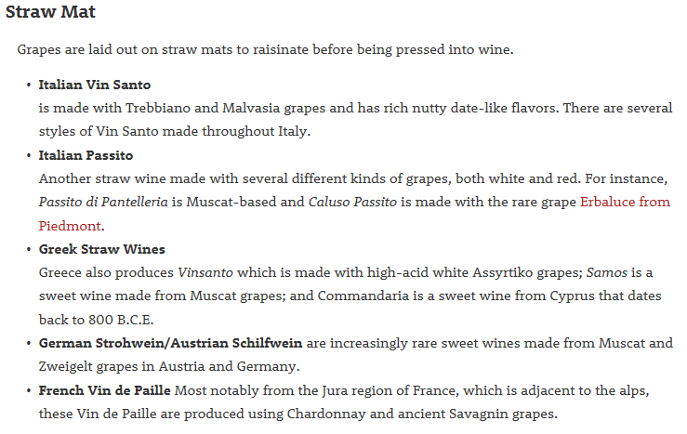
“PASSITO” WINES – MADE FROM PARTIALLY DRIED GRAPES

Slide 10
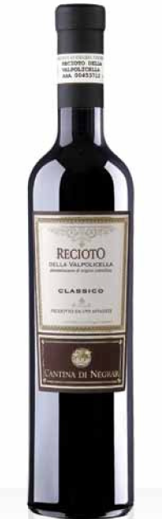
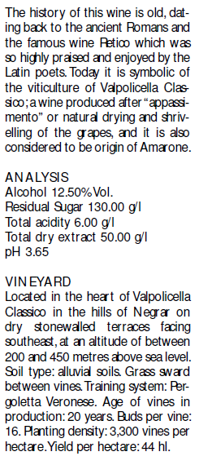
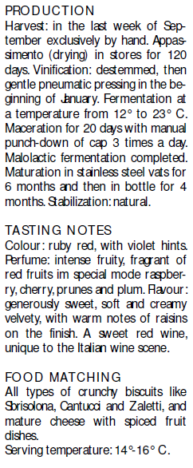

“PASSITO” & “RECIOTO” WINES – MADE FROM PARTIALLY DRIED GRAPES
Tasting Wine:
Cantina Negrar Recioto Valpollicella
~$25/500ml from DeLaurentis

Slide 11
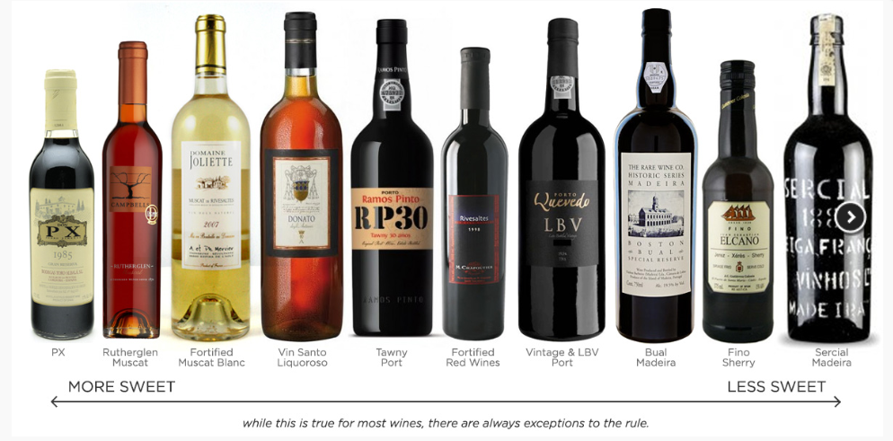
FORTIFIED WINES
Also the VIN DOUX NATUREL (VDN) of France – such as Banyuls (a favorite) and Muscat de Beaumes de Venise

Slide 12
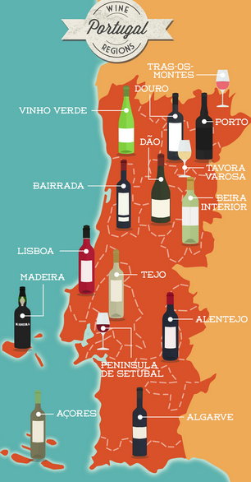
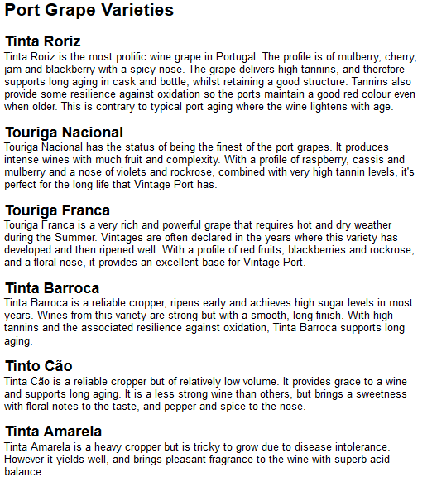
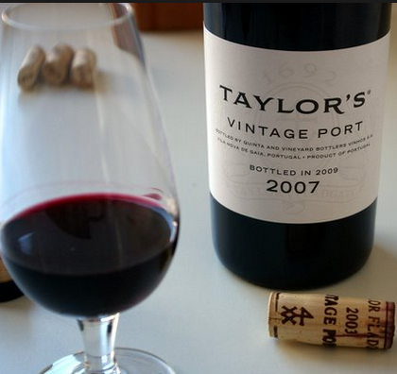
FORTIFIED WINES – What is “Port”?
-fermented part way (~100g/L sugar remaining)
-brandy added to arrest fermentation
= sugar + alcohol (typically 19-21% alc)
-barrel aged

Slide 13

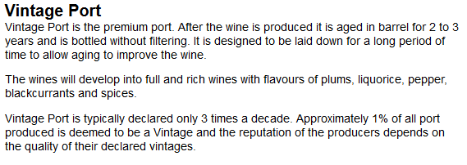
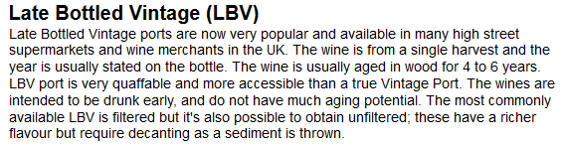
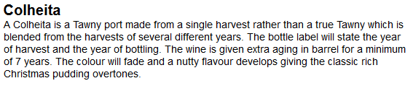
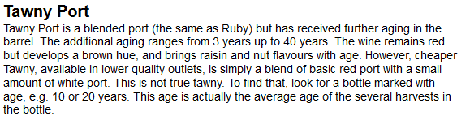
SINGLE VINTAGE
BLENDED VINTAGES
LESS
BARREL AGING
MORE
EXTENDED AGING = “TAWNY”

Slide 14
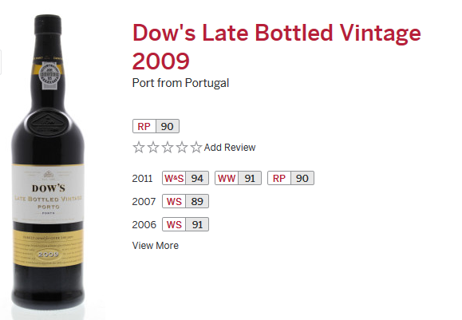
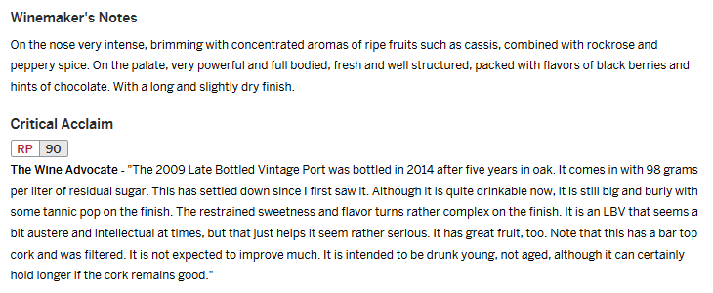
Tasting Wine:
Dow’s LBV Port ~$20 from Esquin

Slide 15
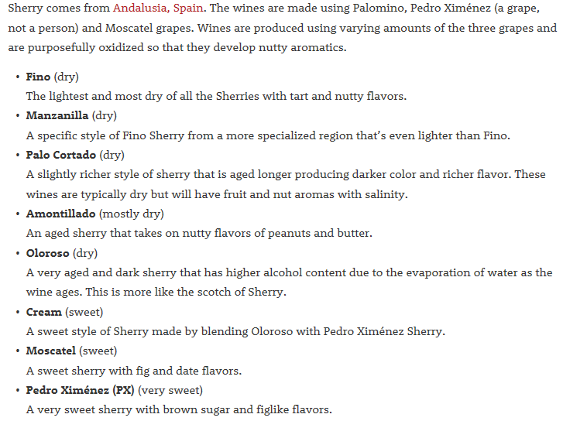
SHERRY - FORTIFIED & OXIDIZED
LESS
SWEETNESS
MORE

Slide 16
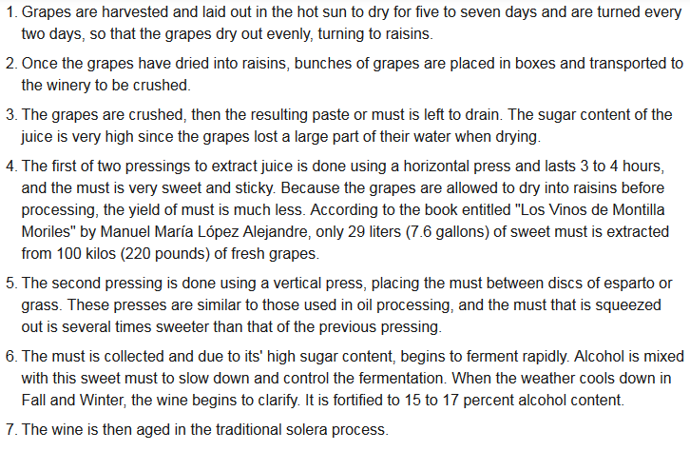
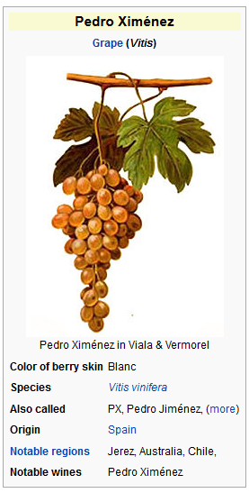
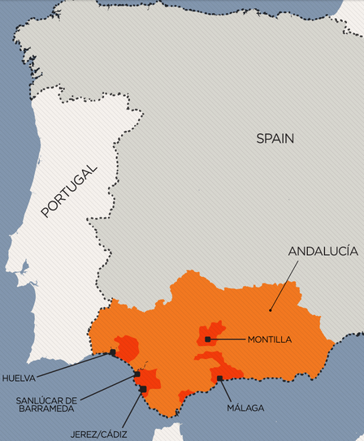
PEDRO XIMENEZ – dried, fermented, fortified, oxidized
Tasting Wine:
Alvear Solera 1927 PX Sherry ~$24/375ml from Esquin

Slide 17
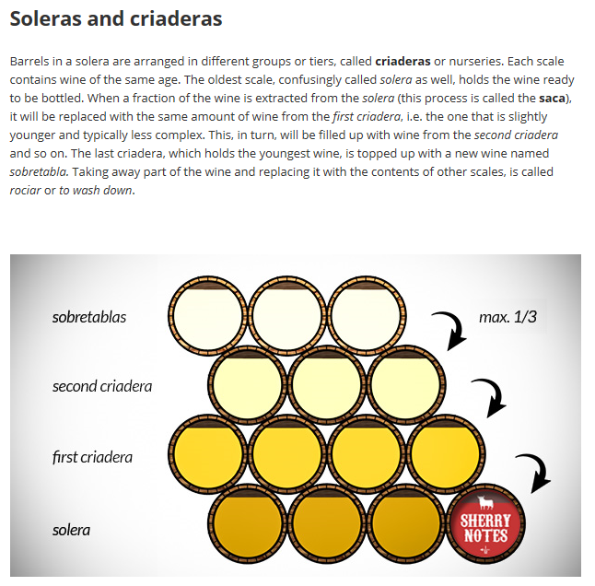
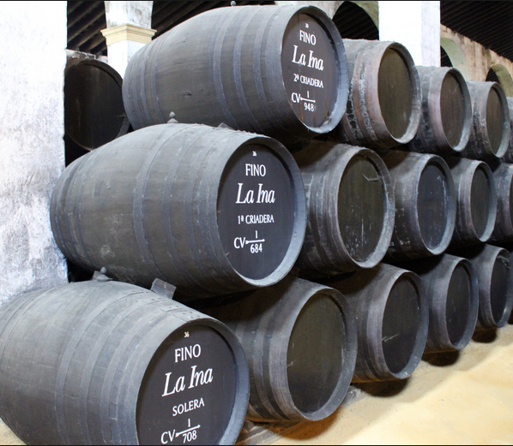
Sherry Barrel Aging – The Solera System
Youngest tier
Oldest tier
1/3 (max) pulled out from oldest tier (“solera”) for bottling.
Replaced with wine from tier above.

